Slide 1
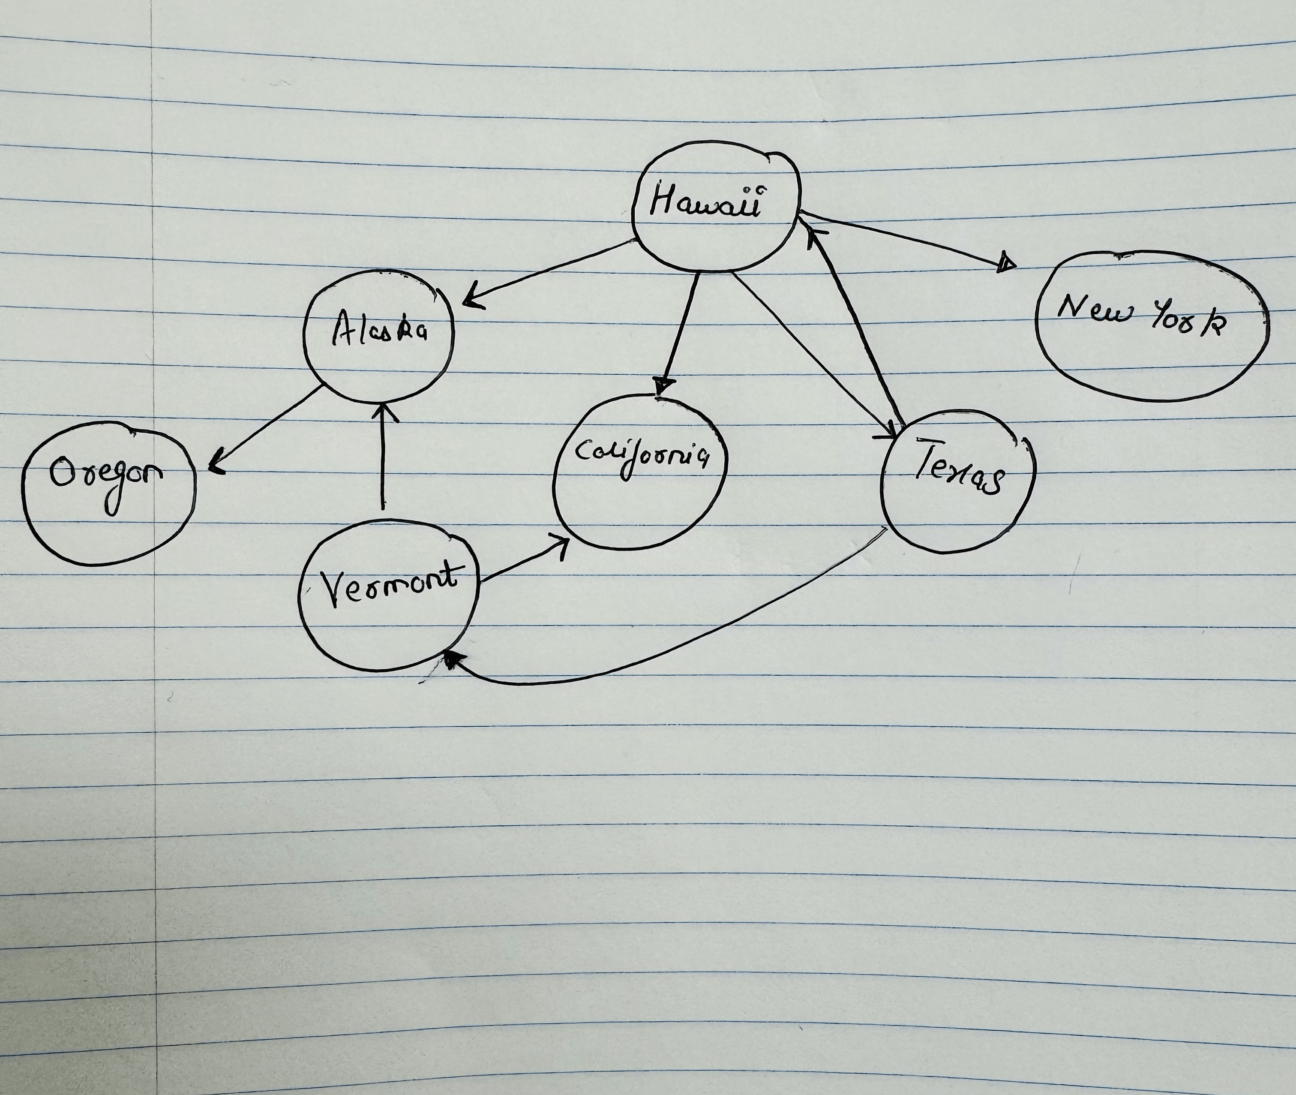
CMSC204
Kartchner
V(StateGraph) = {Oregon, Alaska, Texas, Hawaii, Vermont, NewYork, California}
E(StateGraph) = {(Alaska, Oregon), (Hawaii, Alaska), (Hawaii, Texas), (Texas, Hawaii), (Hawaii, California), (Hawaii, New York), (Texas, Vermont), (Vermont, California), (Vermont, Alaska)}
1. Draw the StateGraph
{Oregon, Alaska, Texas, Hawaii, Vermont, NewYork, California}
{(Alaska, Oregon), (Hawaii, Alaska), (Hawaii, Texas), (Texas, Hawaii), (Hawaii, California), (Hawaii, New York), (Texas, Vermont), (Vermont, California), (Vermont, Alaska)}
No.
Yes.
Texas.

Slide 2
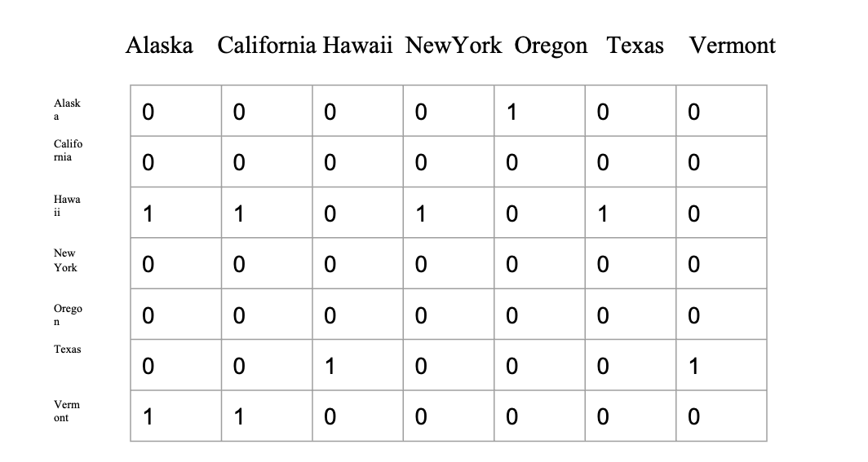
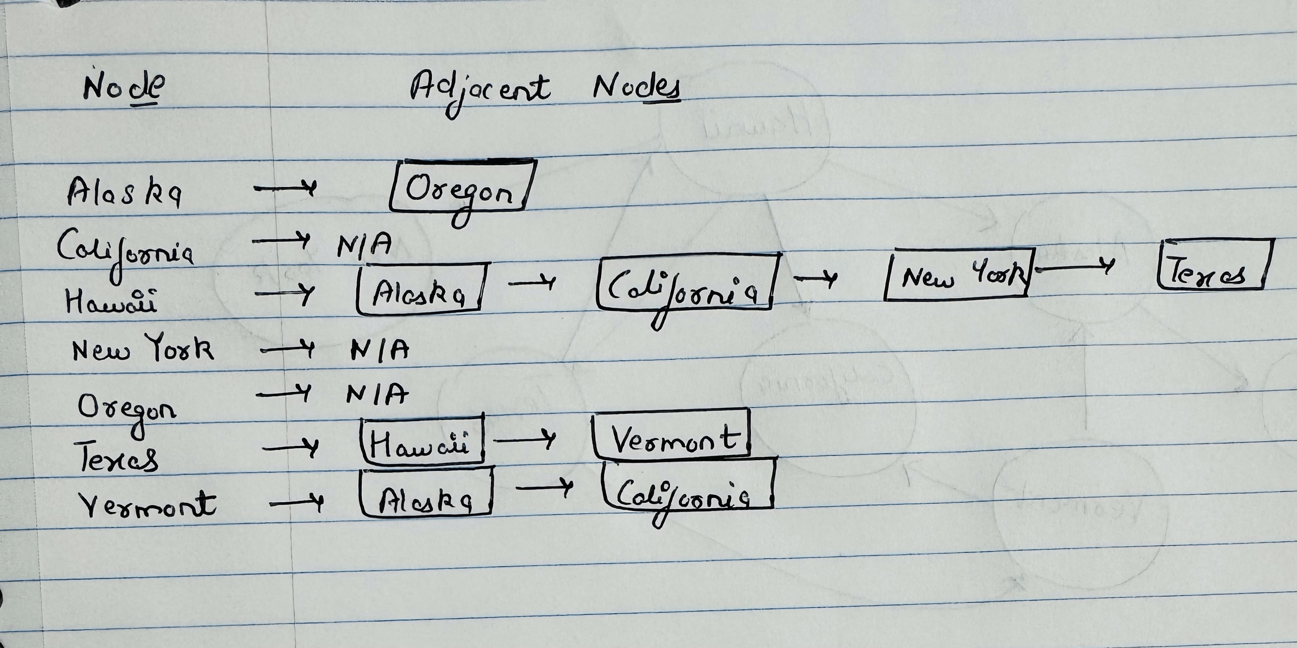
a. Show the adjacency matrix that would describe the edges in the graph. Store the vertices in alphabetical order
0
1
2
3
4
5
6
3. b. Show the adjacency lists
that would describe the edges in the graph

Slide 3
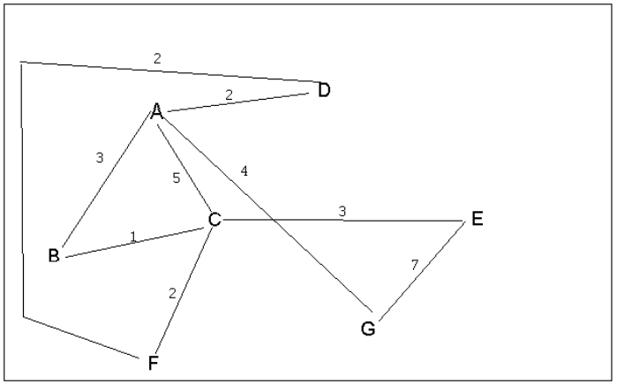
4 a. Which of the following lists the graph nodes in depth first order beginning with E?
A) E, G, F, C, D, B, A
B) G, A, E, C, B, F, D
C) E, G, A, D, F, C, B
D) E, C, F, B, A, D, G
4 b. Which of the following lists the graph nodes in breadth first order beginning at F?
A) F, C, D, A, B, E, G
B) F, D, C, A, B, C, G
C) F, C, D, B, G, A, E
D) a, b, and c are all breadth first traversals

Slide 4
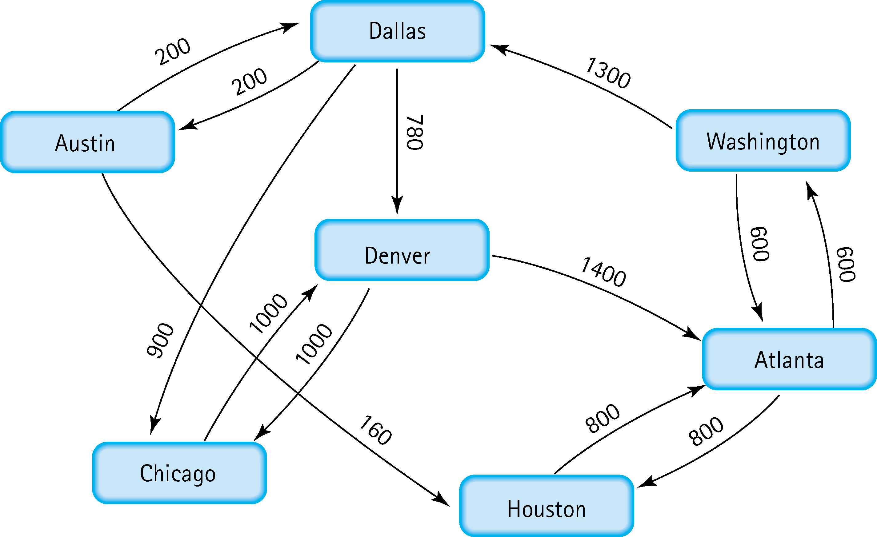
5. Find the shortest distance from Atlanta to every other city
Atlanta -> Washington: 600
Atlanta -> Houston: 800
Atlanta -> Dallas: 1900
Atlanta -> Austin: 2100
Atlanta -> Denver: 2680
Atlanta -> Chicago: 2800

Slide 5
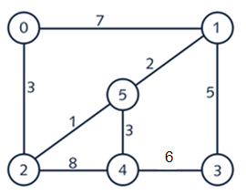
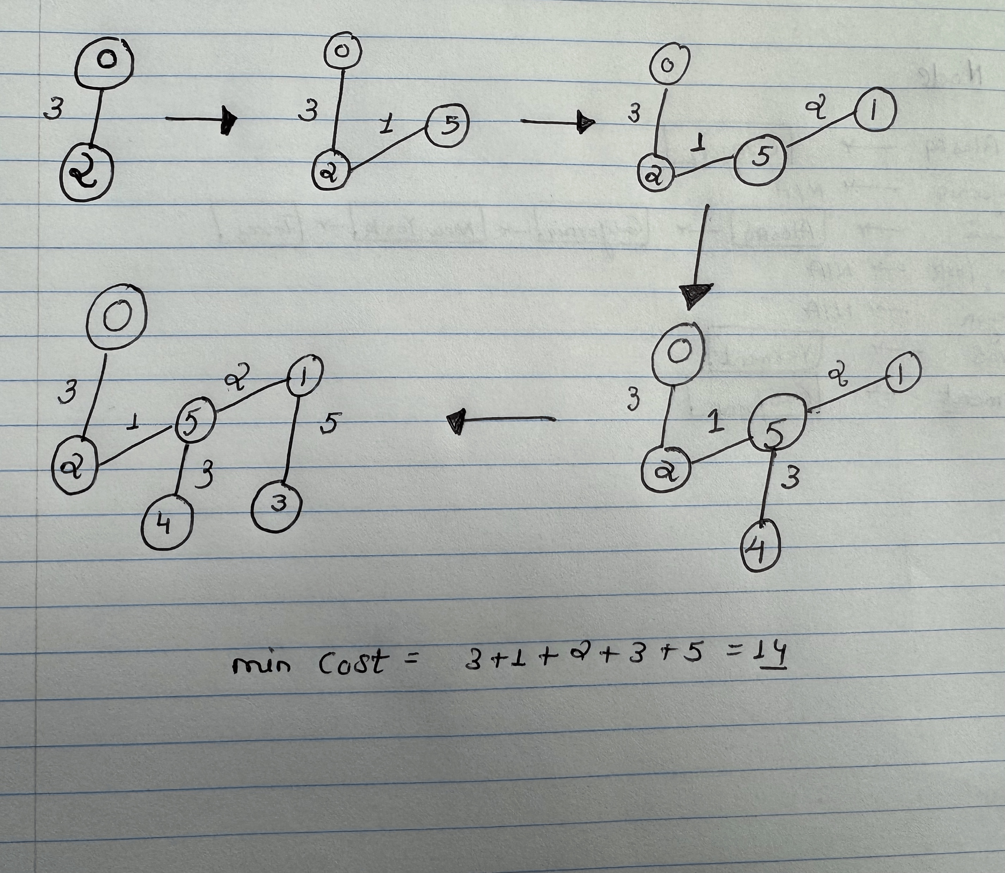
6. Find the minimal spanning tree using Prim’s algorithm. Use
0 as the source vertex . Show the steps.

Slide 6
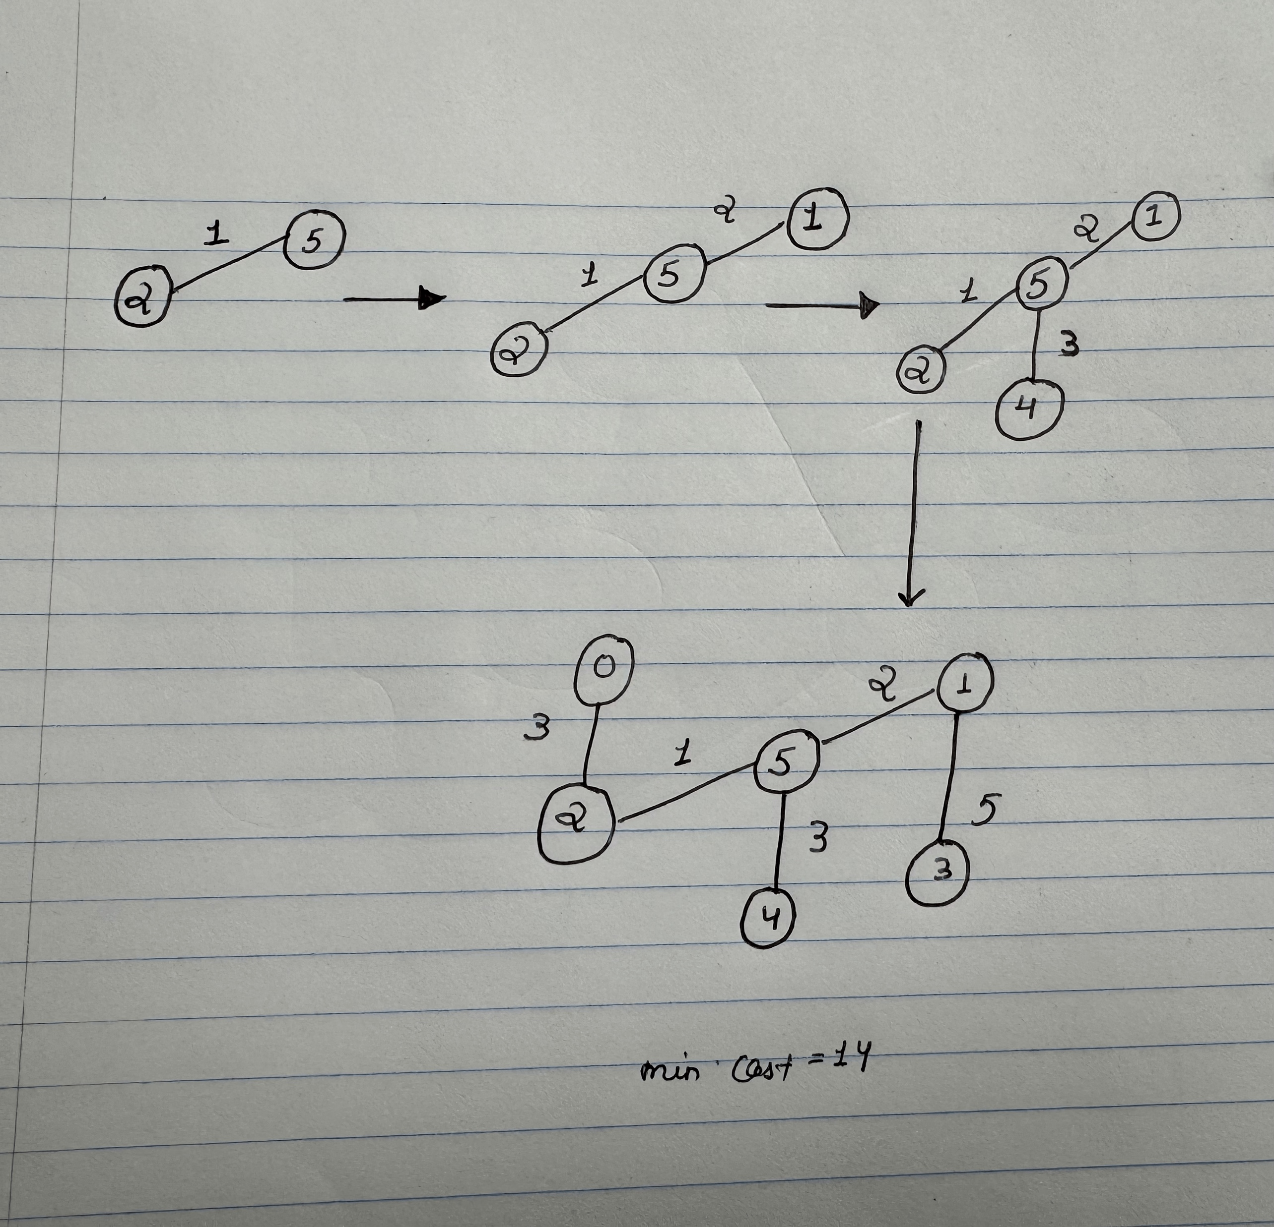
7. Find the minimal spanning tree using Kruskal’s algorithm.
Show the weights in order and the steps.

Slide 7
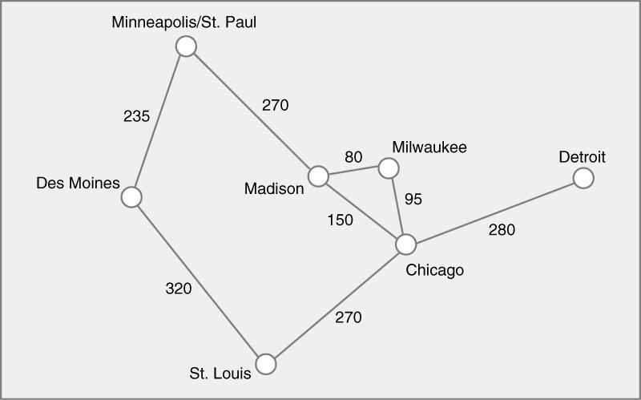
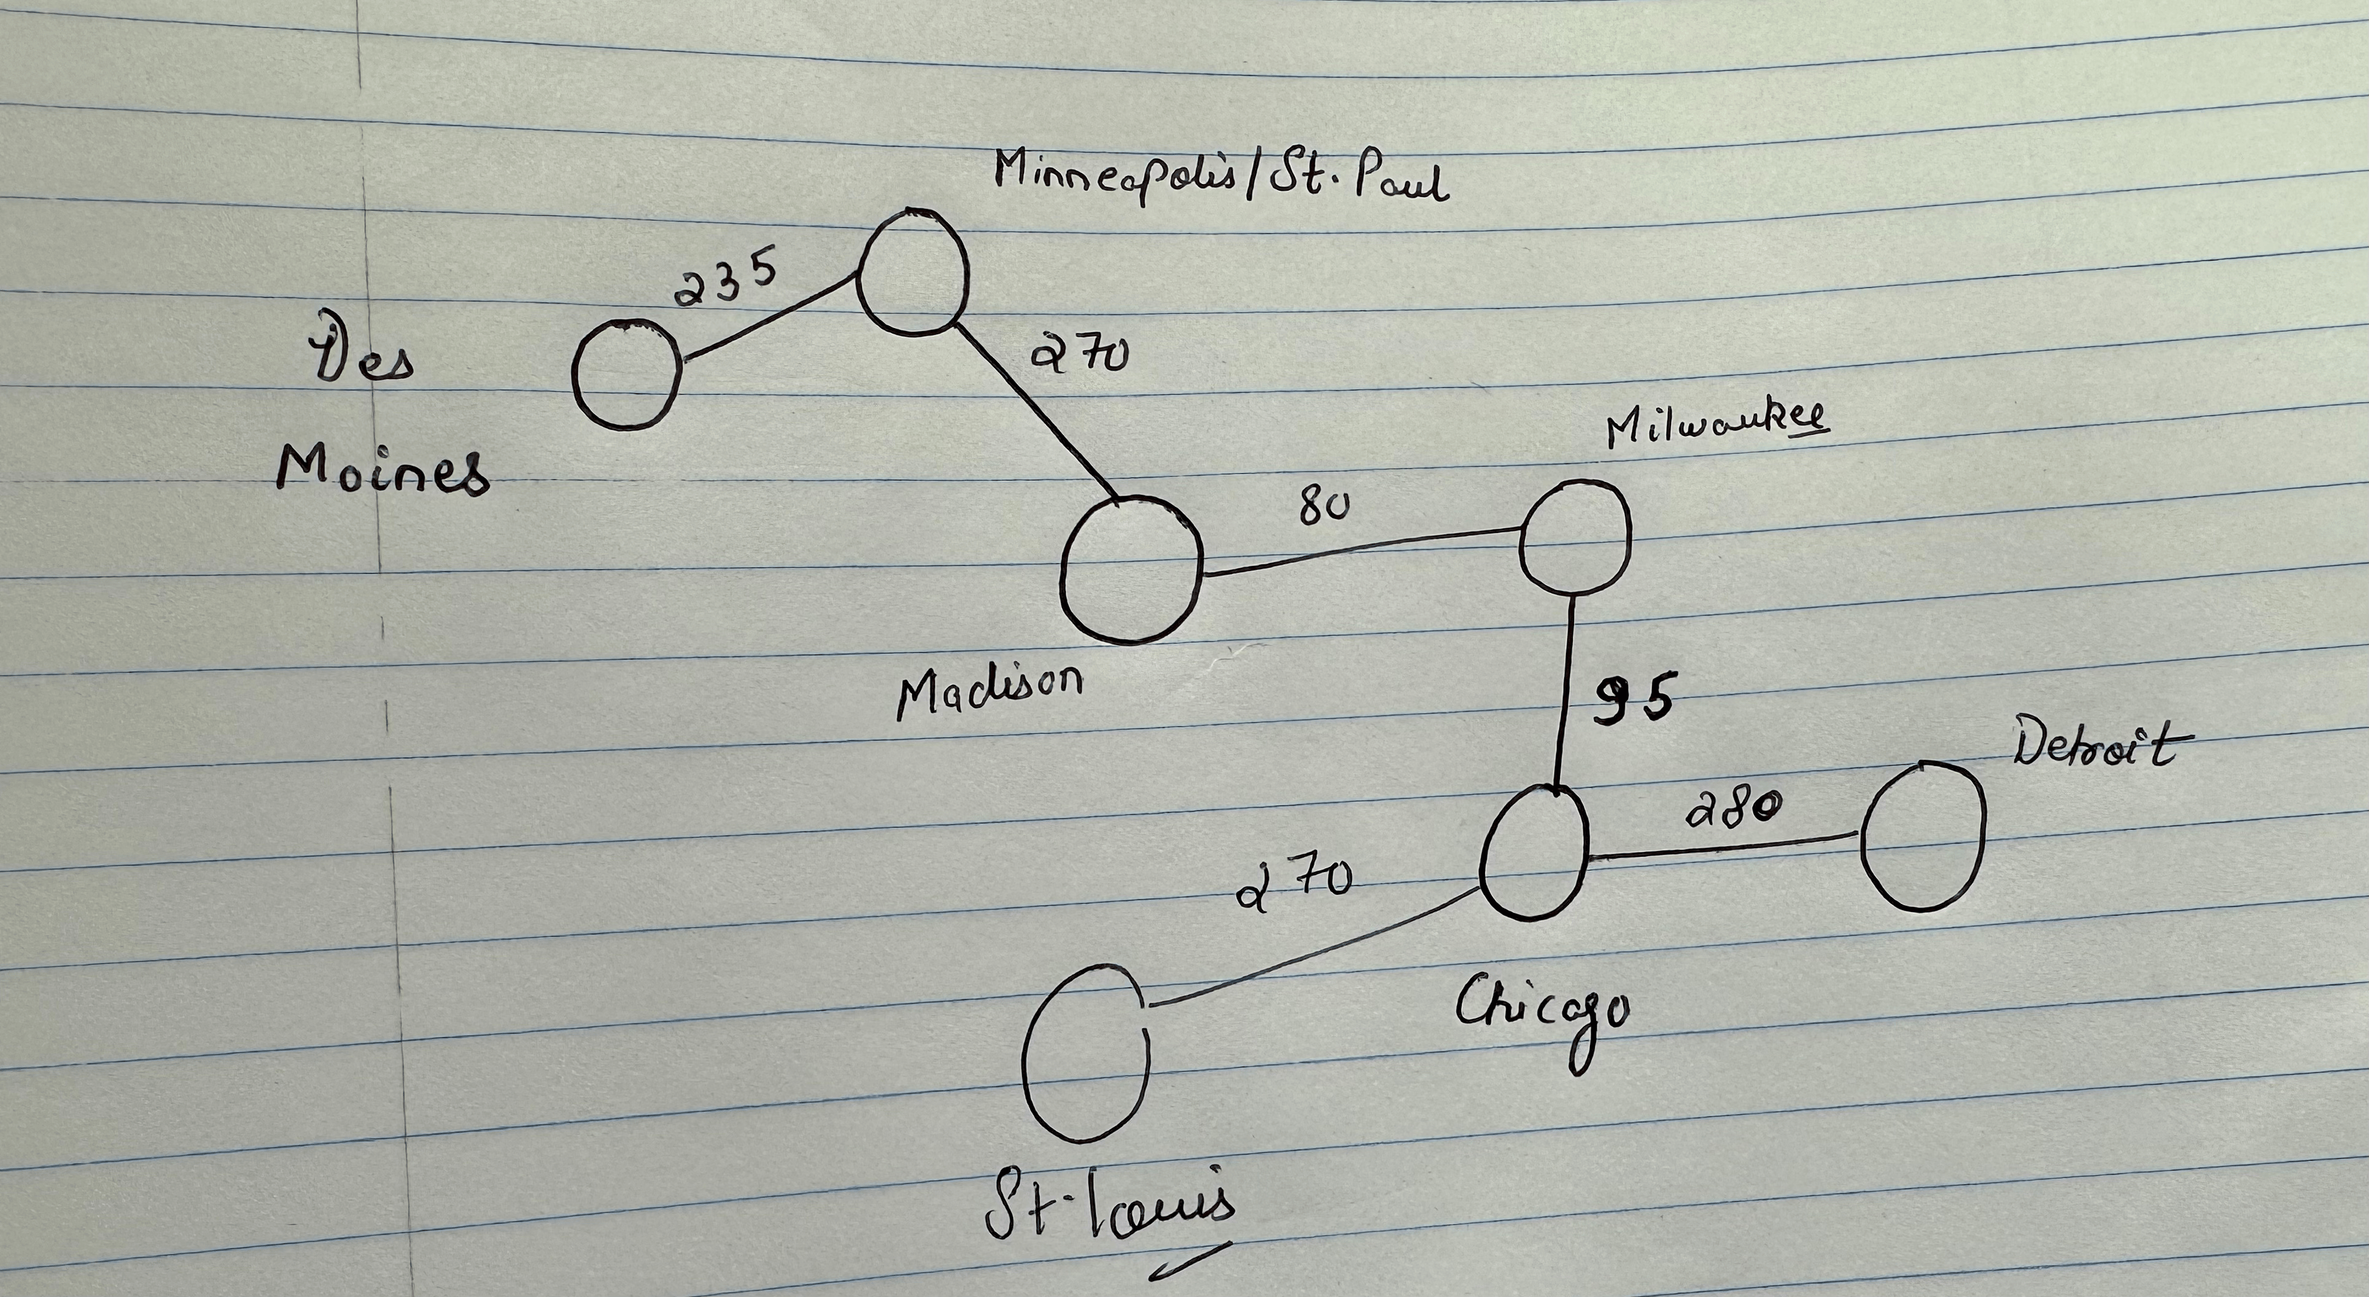
8. Find the minimal spanning tree using the algorithm you prefer. Use
Minneapolis/St. Paul as the source vertex
Using Prim’s Algorithm

Slide 8
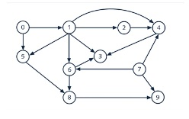
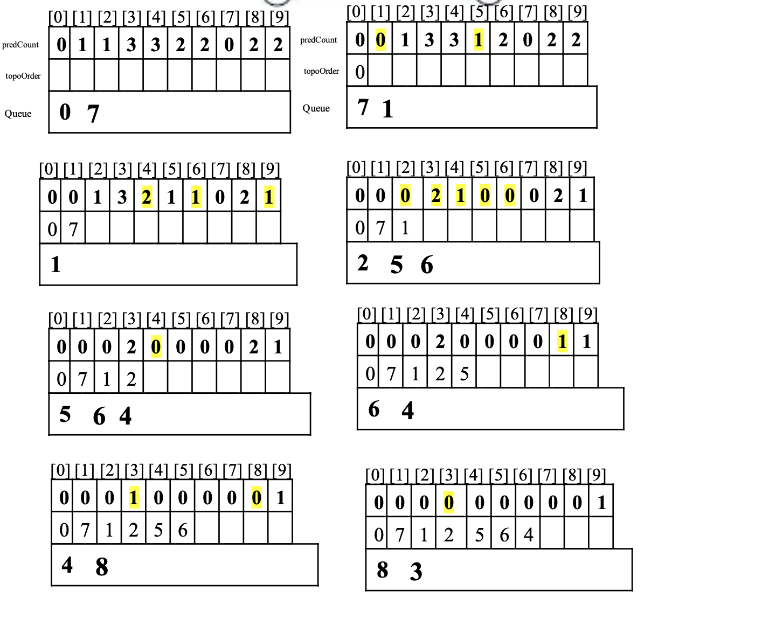
9. List the nodes of the graph in a breadth first topological ordering. Show the
steps using arrays predCount, topologicalOrder and a queue

Slide 9
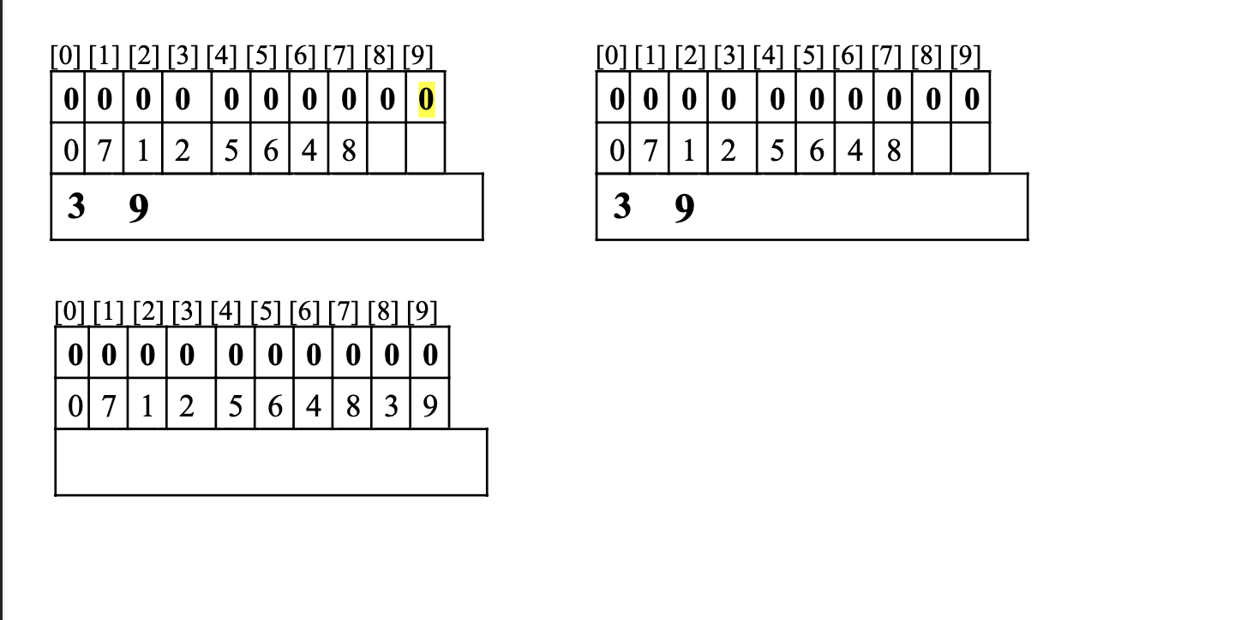

Slide 10
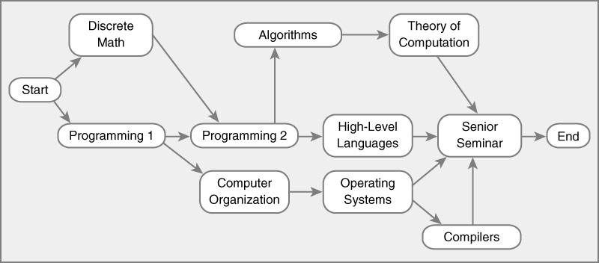
10. List the nodes of the graph in a breadth first topological ordering.
Start, Discrete Math, Programming 1, Programming 2, Computer Organization,
Algorithms, High-Level Languages, Operating Systems, Theory of Computation,
Compilers, Senior Seminar, End

